Slide 1
Python Datatypes, variables, Input output statements

Slide 2
Python Introduction
It is a general-purpose interpreted, interactive, object-oriented, and high-level programming language.
Python works on different platforms (Windows, Mac, Linux, Raspberry Pi, etc).
Python has a simple syntax similar to the English language.
Python has syntax that allows developers to write programs with fewer lines than some other programming languages.
Python runs on an interpreter system, meaning that code can be executed as soon as it is written. This means that prototyping can be very quick.
Python can be treated in a procedural way, an object-oriented way or a functional way.

Slide 3
Why Python?
Python is Interpreted − Python is processed at runtime by the interpreter. You do not need to compile your program before executing it.
Python is Interactive − You can actually sit at a Python prompt and interact with the interpreter directly to write your programs.
Python is Object-Oriented − Python supports Object-Oriented style or technique of programming that encapsulates code within objects.
Python is a Beginner's Language − Python is a great language for the beginner-level programmers and supports the development of a wide range of applications from simple text processing to WWW browsers to games.

Slide 4
Characteristics of Python
It supports functional and structured programming methods as well as OOP.
It can be used as a scripting language or can be compiled to byte-code for building large applications.
It provides very high-level dynamic data types and supports dynamic type checking.
It supports automatic garbage collection.
It can be easily integrated with C, C++, COM, ActiveX, CORBA, and Java.

Slide 5
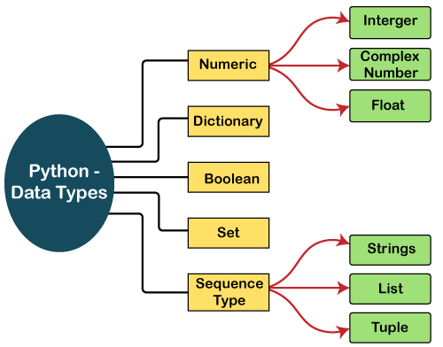
Python Data Types

Slide 6
Python Data Types
Variables can hold values, and every value has a data-type.
Python is a dynamically typed language; hence we do not need to define the type of the variable while declaring it.
The interpreter implicitly binds the value with its type.
For Example, a = 5 . The variable a holds integer value five and we did not define its type.
Python interpreter will automatically interpret variables a as an integer type.
Python provides us the type() function, which returns the type of the variable passed.

Slide 7
Numbers
Number stores numeric values. Numeric Types: int, float, complex
Int - Integer value can be any length such as integers 10, 2, 29, -20, -150 etc. Python has no restriction on the length of an integer. Its value belongs to int
Float - Float is used to store floating-point numbers like 1.9, 9.902, 15.2, etc. It is accurate upto 15 decimal points.
complex - A complex number contains an ordered pair, i.e., x + iy where x and y denote the real and imaginary parts, respectively. The complex numbers like 2.14j, 2.0 + 2.3j, etc.
Python creates Number objects when a number is assigned to a variable.

Slide 8
Numbers
Python Script
a = 5
print(a)
print("The type of a", type(a))
b = 40.5
print(b)
print("The type of b", type(b))
c = 1+3j
print(c)
print("The type of c", type(c))
OUTPUT
5
The type of a <class 'int'>
40.5
The type of b <class 'float'>
(1+3j)
The type of c <class 'complex'>

Slide 9
Numbers
Prefix | Interpretation | Base
0b (zero + lowercase letter 'b') 0B (zero + uppercase letter 'B') | Binary | 2
0o (zero + lowercase letter 'o') 0O (zero + uppercase letter 'O') | Octal | 8
0x (zero + lowercase letter 'x') 0X (zero + uppercase letter 'X') | Hexadecimal | 16

Slide 10
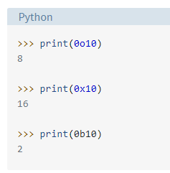
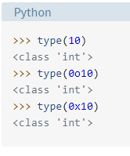
Numbers
print(10+1)
Output
11
print(123123123123123123123123123123123123123123123123 + 1)
Output
123123123123123123123123123123123123123123123124
The underlying type of a Python integer, irrespective of the base used to specify it, is called int:

Slide 11
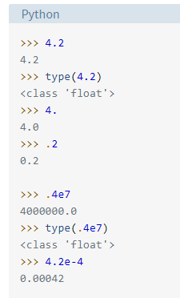
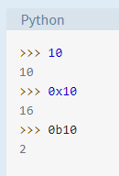
Numbers
Just typing the value at the >>> prompt and hitting Enter will display it. print() function is not mandatory to display the value

Slide 12
String
The string can be defined as the sequence of characters represented in the quotation marks.
In Python, we can use single, double, or triple quotes to define a string.

Slide 13
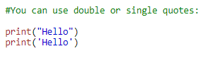





String
Multiline Strings

Slide 14
List
Python Lists are similar to arrays in C.
A list object is an ordered collection of one or more data items changeable.
The list can contain data of different types.
The items stored in the list are separated with a comma (,) and enclosed within square brackets [].
We can use slice [:] operators to access the data of the list.
Lists have no fixed size and can be expanded or contracted as needed.
Items in list can be retrieved using the index.
Lists can be nested just like arrays, i.e., you can have a list of lists

Slide 15






List

Slide 16
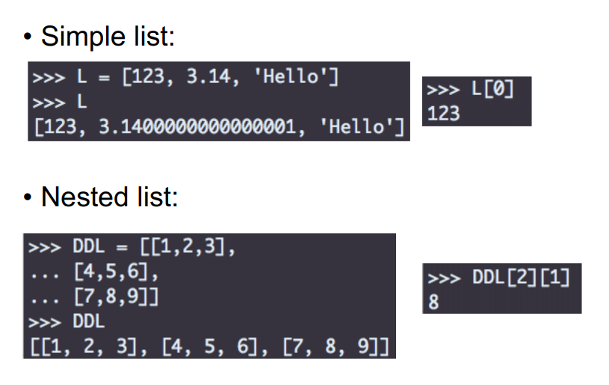
List

Slide 17



Tuple
A tuple is a collection which is ordered and unchangeable.
In Python tuples are written with round brackets.

Slide 18
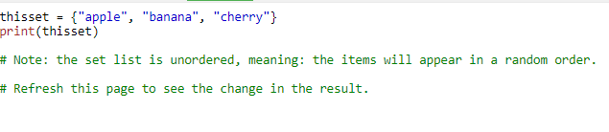


Set
A set is a collection which is unordered and unindexed. In Python, sets are written with curly brackets.
Result after First RUN
Result after Second RUN

Slide 19
Dictionary
A dictionary is a collection which is unordered, changeable and indexed.
In Python dictionaries are written with curly brackets, and they have keys and values.
Each key is separated from its value by a colon (:), the items are separated by commas, and the whole thing is enclosed in curly braces.
An empty dictionary without any items is written with just two curly braces, like this: {}.
Keys are unique within a dictionary while values may not be. The values of a dictionary can be of any type, but the keys must be of an immutable data type such as strings, numbers, or tuples.

Slide 20
Dictionary
dict = {'Name': 'Zara', 'Age': 7, 'Class': 'First'}
Pair1: ‘Name’:’Zara’
Key is Name and its value is Zara
Pair 2: 'Age': 7
Key is Age and its value is 7

Slide 21
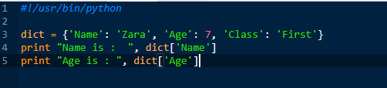

Accessing Values in Dictionary
To access dictionary elements, you can use the familiar square brackets along with the key to obtain its value.
Following is a simple example −
OUTPUT

Slide 22
Boolean
Booleans represent one of two values: True or False.
You can evaluate any expression in Python, and get one of two answers, True or False.
When you compare two values, the expression is evaluated and Python returns the Boolean answer:
Example
print(10 > 9) print(10 == 9) print(10 < 9)
OUTPUT:
True False False

Slide 23


Boolean
Evaluate Values and Variables:
The bool() function allows you to evaluate any value, and give you True or False in return,
Example
Evaluate a string and a number:

Slide 24


Boolean
Most Values are True
Almost any value is evaluated to True if it has some sort of content.
Any string is True, except empty strings.
Any number is True, except 0.
Any list, tuple, set, and dictionary are True, except empty ones.

Slide 25
Input and Output in Python

Slide 26
Taking Input from the user
Python provides an input() function to accept input from the user.
Syntax:
input('prompt')
where, prompt is a string that is displayed on the string at the time of taking input.
Example:
# Assume the user entered input is AMRITA“ (# represents comments in python)
name = input("Enter your name: ")
print(name)
OUTPUT:
AMRITA

Slide 27
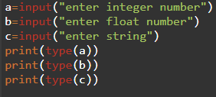
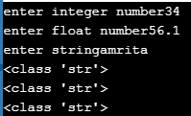
Taking Input from the user
Python Script
OUTPUT
Note: By default input() function takes the user’s input in a string.
So, to take the input in the form of int, you need to use int() along with input function.

Slide 28
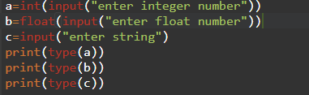

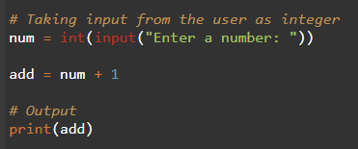

Taking Input from the user
Python Script
OUTPUT

Slide 29
Displaying Output
Python provides the print() function to display output to the console.
Syntax
print(object(s), sep=separator, end=end, file=file, flush=flush)
Parameter Values
Parameter | Description
object(s) | Any object, and as many as you like. Will be converted to string before printed
sep='separator' | Optional. Specify how to separate the objects, if there is more than one. Default is ' '
end='end' | Optional. Specify what to print at the end. Default is '\n' (line feed)
file | Optional. An object with a write method. Default is sys.stdout
flush | Optional. A Boolean, specifying if the output is flushed (True) or buffered (False). Default is False

Slide 30
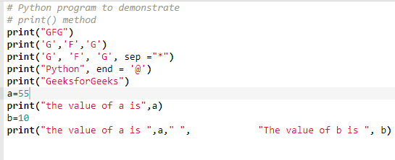
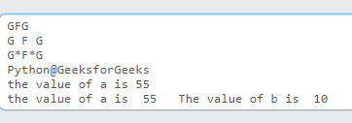
Displaying Output
Python Script
OUTPUT

Slide 31

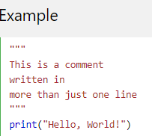
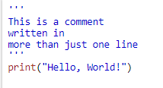
Python Comments
Comments can be used to make the code more readable.
Comments starts with a #, and Python will ignore them:
Example:
Multi Line Comments (use triple single quotes or double quotes)

Slide 32
Python Variables
Variables:
Variables are containers for storing data values.
Unlike other programming languages, Python has no command for
declaring a variable.
A variable is created the moment you first assign a value to it.
Python script
x = 5
y = "John"
print(x)
print(y)
Output
5
John

Slide 33
Variable Names
A variable can have a short name (like x and y) or a more descriptive name (age, carname, total_volume).
Rules for Python variables:
A variable name must start with a letter or the underscore character
A variable name cannot start with a number
A variable name can only contain alpha-numeric characters and underscores (A-z, 0-9, and _ )
Variable names are case-sensitive (age, Age and AGE are three different variables)

Slide 34
Variable Names
#Legal variable names:
myvar = "John"
my_var = "John"
_my_var = "John"
myVar = "John"
MYVAR = "John"
myvar2 = "John"
#Illegal variable names:
2myvar = "John"
my-var = "John"
my var = "John"

Slide 35
Assign Value to Multiple Variables
Python allows you to assign values to multiple variables in one line:
Example
x, y, z = "Orange", "Banana", "Cherry" print(x) print(y) print(z)
OUTPUT
Orange Banana Cherry

Slide 36
Assigning same value to multiple variables in one line:
Example
x = y = z = "Orange" print(x) print(y) print(z)
OUTPUT
Orange Orange Orange

Slide 37
Output Variables
The Python print statement is often used to output variables.
To combine both text and a variable, Python uses the + character:
Example:
x = "awesome" print("Python is " + x)
Output:
Python is awesome
+ character to add a variable to another variable:
Example
x = "Python is " y = "awesome" z = x + y print(z)
Output:
Python is awesome

Slide 38
Output Variables
x = 5
y = "John"
print(x + y)
Output:
TypeError: unsupported operand type(s) for +: 'int' and 'str'

Slide 39
Python Casting
There may be times when you want to specify a type on to a variable. This can be done with casting.
Casting in python is done using constructor functions:
int() - constructs an integer number from an integer literal, a float literal (by rounding down to the previous whole number), or a string literal (providing the string represents a whole number)
float() - constructs a float number from an integer literal, a float literal or a string literal (providing the string represents a float or an integer)
str() - constructs a string from a wide variety of data types, including strings, integer literals and float literals

Slide 40
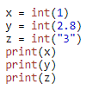
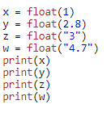

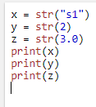

Python Casting

Slide 41
Python Operators
Python divides the operators in the following groups:
Arithmetic operators
Assignment operators
Comparison operators
Logical operators
Identity operators
Membership operators
Bitwise operators

Slide 42
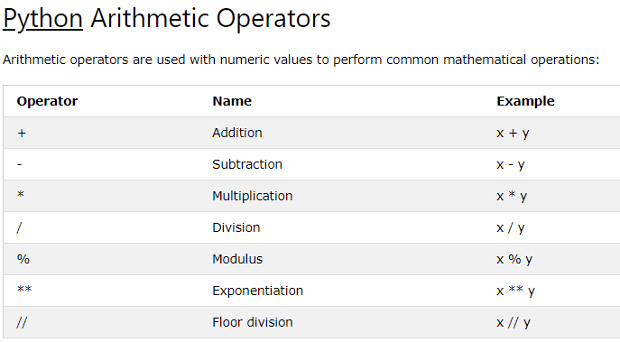
Note:
Floor Division (//) –
The division of operands where the result is the quotient in which the digits after the decimal point are removed. But if one of the operands is negative, the result is floored, i.e., rounded away from zero (towards negative infinity) −
9//2 = 4
9.0//2.0 = 4.0,
-11//3 = -4
-11.0//3 = -4.0

Slide 43
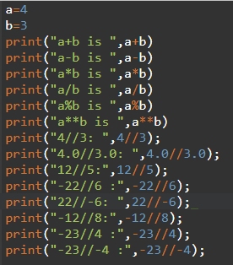
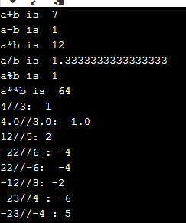
Arithmetic operators
Python Script
OUTPUT

Slide 44
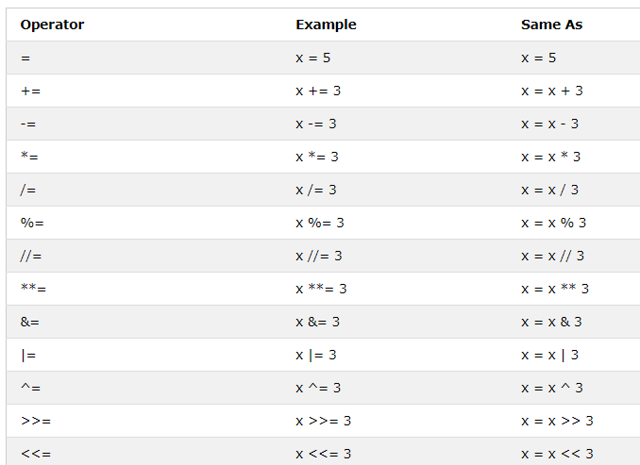
Python Assignment Operators

Slide 45
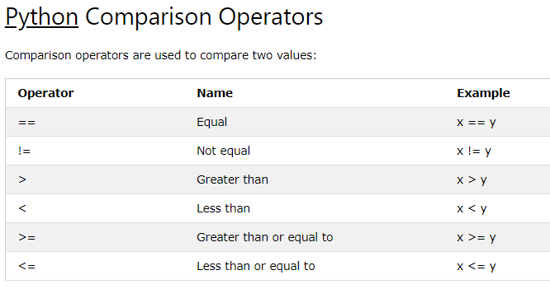

Slide 46
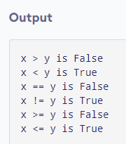
Python Comparison Operators
Python Script
x = 10
y = 12
print('x > y is',x>y)
print('x < y is',x<y)
print('x == y is',x==y)
print('x != y is',x!=y)
print('x >= y is',x>=y)
print('x <= y is',x<=y)

Slide 47
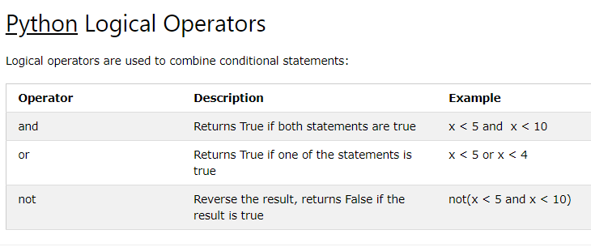

Slide 48
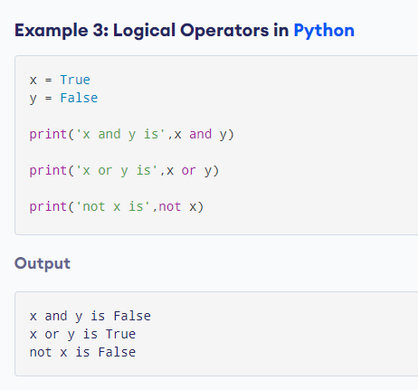

Slide 49
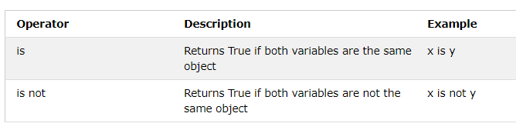
Python Identity Operators:
Identity operators are : is and is not
They are used to check if two values (or variables) are located on the same part of the memory. Two variables that are equal does not imply that they are identical.

Slide 50
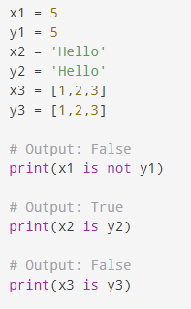
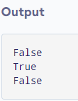
Python Identity Operators

Slide 51
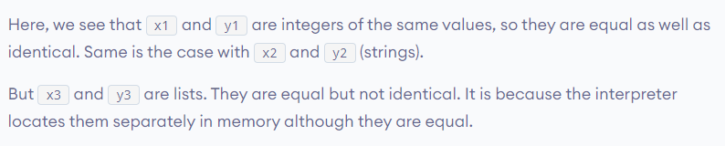
Python Identity Operators
Explanation:

Slide 52
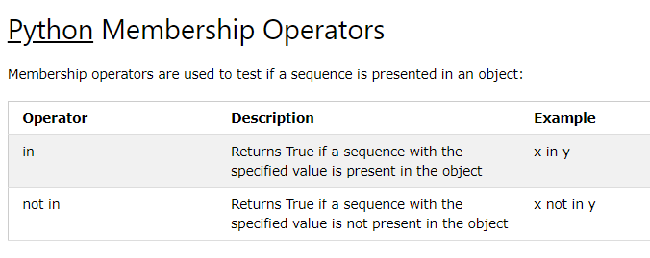
Membership operators are used to test whether a value or variable is found in a sequence (string, list, tuple, set and dictionary).
In a dictionary we can only test for presence of key, not the value.

Slide 53
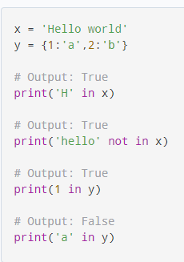
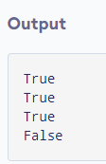
Python Membership Operators

Slide 54
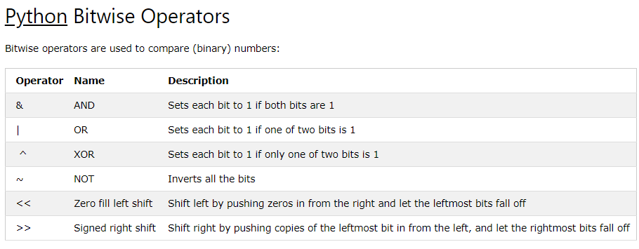

Slide 55
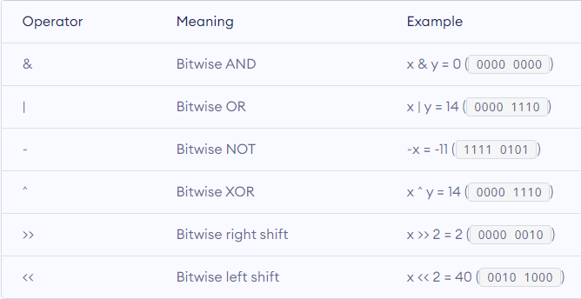
Python Bitwise Operators
Let x = 10 (0000 1010 in binary) and y = 4 (0000 0100 in binary

Slide 56
Arithmetic operations on strings
+ operator (for concatenation):
When you use + on strings, it will concatenate them together.
print('hello' + 'world')
Output:
helloworld
* Operator (for repetition):
When you multiply a string by an integer, n, the string will be repeated n times:
print('hello' * 3)
Output:
hellohellohello
Note:
If you place two strings next to each other, they will also be concatenated:
print('hello' 'world')
Output:
helloworld

Slide 57
Discussion

Slide 58
What is the maximum possible length of an identifier?
a) 31 characters b) 63 characters c) 79 characters d) none of the mentioned
Answer: d Explanation: Identifiers can be of any length.

Slide 59
Which of the following is invalid?
a) _a = 1 b) __a = 1 c) __str__ = 1 d) none of the mentioned
Answer: d

Slide 60
What will be the output of the following program on execution?
if False: print ("inside if block") elif True: print ("inside elif block") else: print ("inside else block")
A. inside if block B. inside elif block C. inside else block D. Error
Ans : B

Slide 61
What will be the output of following Python code snippet?
str1="012" num1=2 num2=0 for i in range(4): num1+=2 for j in range(len(str1)): num2=num2+num1 num3=num2%int(str1) print(num3)
A. 7 B. Infinite Loop C. 0 D. Error
Ans : C

Slide 62
What is the type of inf ?
a) Boolean b) Integer c) Float d) Complex
Answer: c
Explanation: Infinity is a special case of floating point numbers. It can be obtained by float(‘inf’

Slide 63
Which of the following is incorrect?
a) x = 0b101 b) x = 0x4f5 c) x = 19023 d) x = 03964
Answer: d
Explanation: Numbers starting with a 0 are octal numbers but 9 isn’t allowed in octal numbers.

Slide 64
What will be the output of the following Python code?
i = 1
while True:
if i%0O7 == 0:
break
print(i)
i += 1
a)1 2 3 4 5 6
b)1 2 3 4 5 6 7
c)Error
d) none of the mentioned
Answer: a

Slide 65

What will be the output of the following Python code?
for i in range(2.0):
print(i)
Answer: c
Explanation: Object of type float cannot be interpreted as an integer.

Slide 66

What will be the output of the following Python code?
for i in range(int(2.0)):
print(i)
Answer: b Explanation: range(int(2.0)) is the same as range(2).

